Slide 1

Capstone Final Project: Plume Analysis
Justin Tice & Megan Hoeksema
March 1, 2023

Slide 2
Monitoring in the Lekagul Wildlife Preserve Area
Mistford Pact of 2010 - ensure an environmentally sound and economically supportive partnership
9 air-sampling sensors are located around the town and in the preserve to monitor air quality.
Chemicals
AGOC-3 - Low-VOC: volatile organic compounds that are not harmful to the environment and humans.
Appluimonia - Odor producing substance, not at high enough levels that can cause serious harm, long-term heath effects or even death in humans and animals.
Chlorodinine - Corrosive disinfectant/sterilizing agent that is harmful if inhaled or swallowed.
Methylsomolene – A volatile organic compound that causes toxic side effects in vertebrates
Companies near the town
Roadrunner Fitness Electronics
Produces person fitness trackers, heart rate monitors, etc…
Kasios Office Furniture
Produces metal and composite-wood furniture
Radiance ColourTek
Produces solvent based optically variable metallic flake paints.
Indigo Sol Boards
Produces skateboards and snowboards

Slide 3
Research Questions
Characterize the sensors’ performance and operation. Are they all working properly at all times? Can you detect any unexpected behaviors of the sensors through analyzing the readings they capture?
Now turn your attention to the chemicals themselves. Which chemicals are being detected by the sensor group? What patterns of chemical releases do you see, as being reported in the data?
Which factories are responsible for which chemical releases? Carefully describe how you determined this using all the data you have available. For the factories you identified, describe any observed patterns of operation revealed in the data.

Slide 4
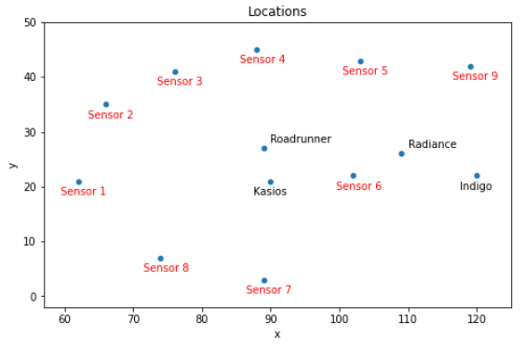
Datasets
Sensor data
3 months (April, August, December), every hour/day/month
9 different sensors
Readings of each chemical in parts per million (ppm)
Meteorological data
Location data
Gives the x, y coordinates for 9 sensors and 4 factories
Calculated the distances between each factory and sensor

Slide 5
Data Preparation
Sensor Data
Rename column titles. The Date Time column has a whitespace at the end.
Convert the date time column to datetime in order to create visualizations.
No null values.
Meteorological Data
Location Data
Data was provided in word file.
Pandas DF manually created.

Slide 6
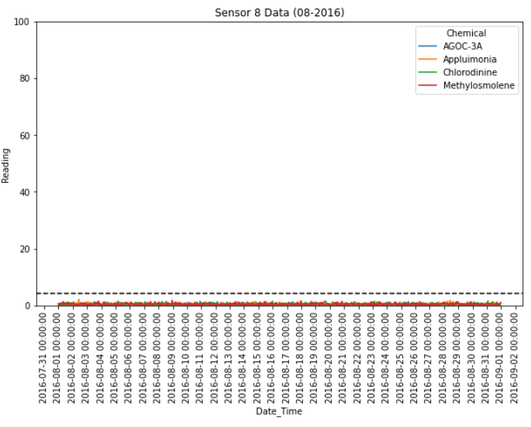
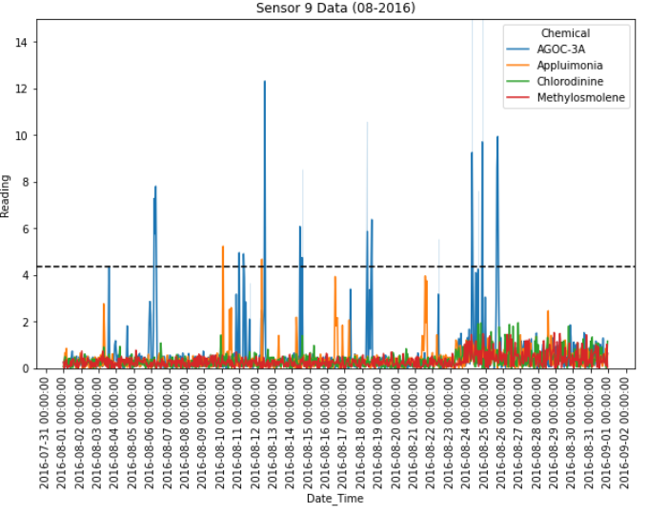
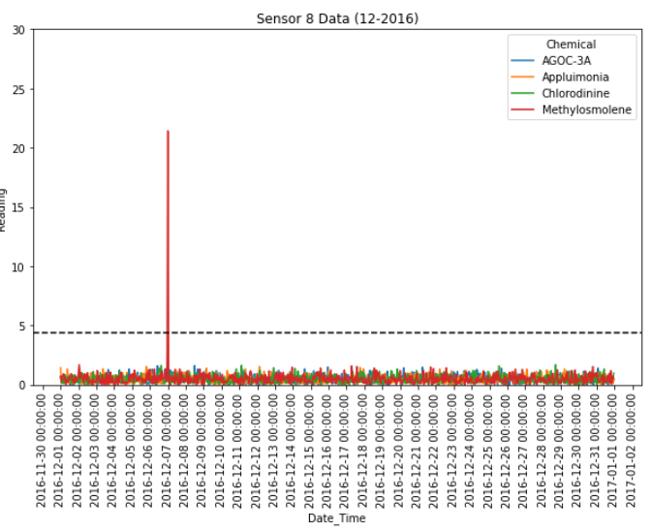
Characterization of the sensors’ performance and operation
Potentially Faulty Sensors/Unexpected Patters in Sensor Behavior
Sensor 8
In April, sensor is picking up 12 significant signals in ¾ chemicals. Going into August, it is only detecting background noise. Then going into December, only 1 spike in Methylosmolene is detected.
Sensor 9
In August, the background noise increases towards the end of the month.

Slide 7
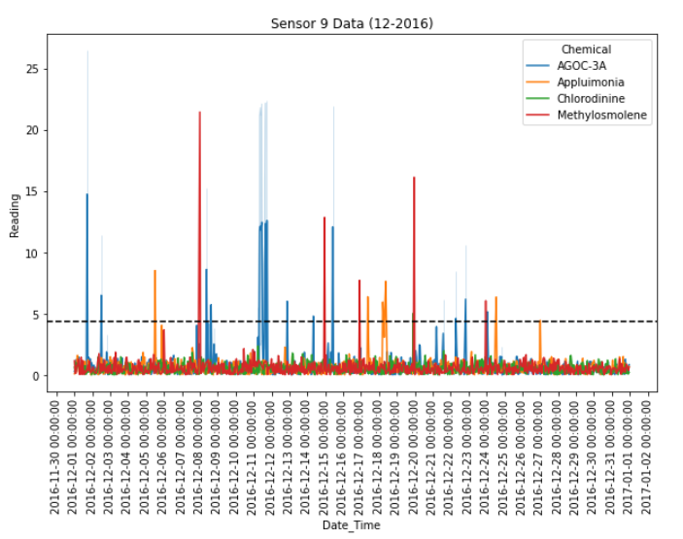
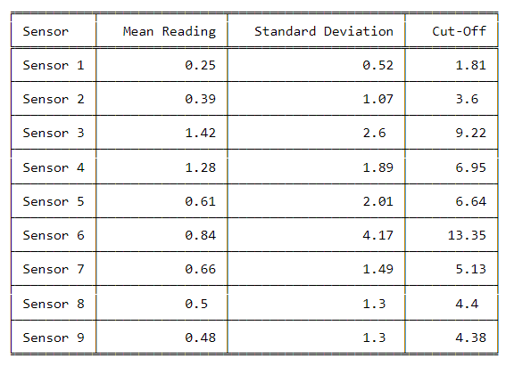
Which chemicals are being detected by the sensor group?
In order to determine if a significant increase is being detected by each sensor, the mean of all readings in the sensor group was calculated, then the cutoff for significance was assigned as the mean + ( 3 * standard deviation).
Significance Cut-Off Calculations

Slide 8
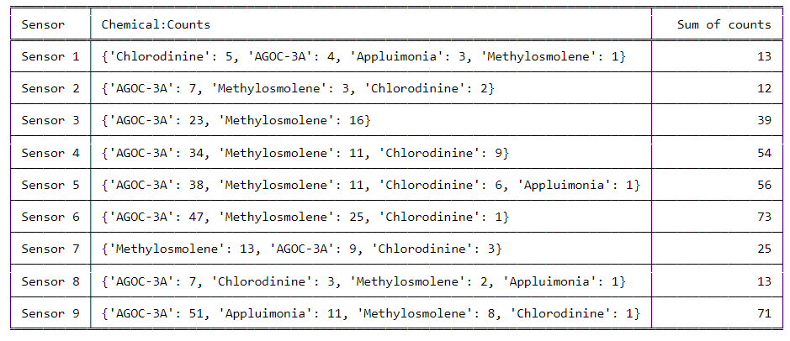
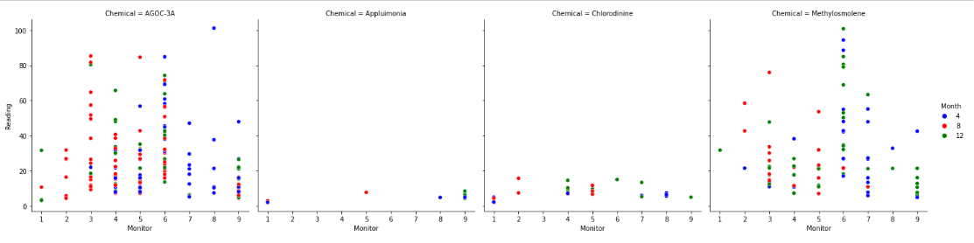
Which chemicals are being detected by the sensor group?
After determining the significance cut-offs, we then extracted the chemicals being detected above the cut-off for each sensor. Also extracted the number of times each chemical was being detected significantly.
Appluimonia is the least detected and detected at very low levels
Chlorodinine is detect on almost every sensor, however, at very low levels.
AGOC-3A is the most detected
AGOC-3A and Methylosmolene are detected on every sensor
Sensors 6 and 9 have the highest number of times chemicals are detected

Slide 9
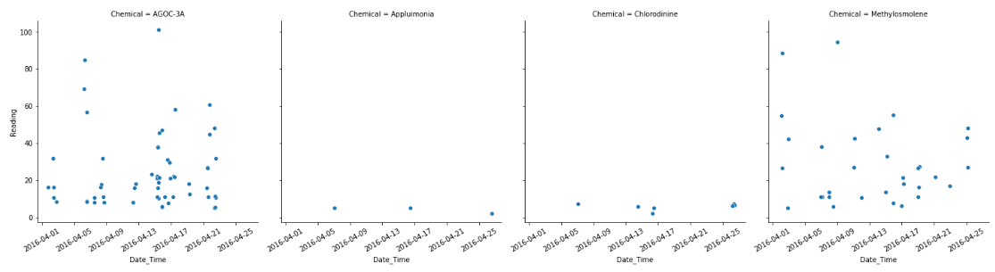
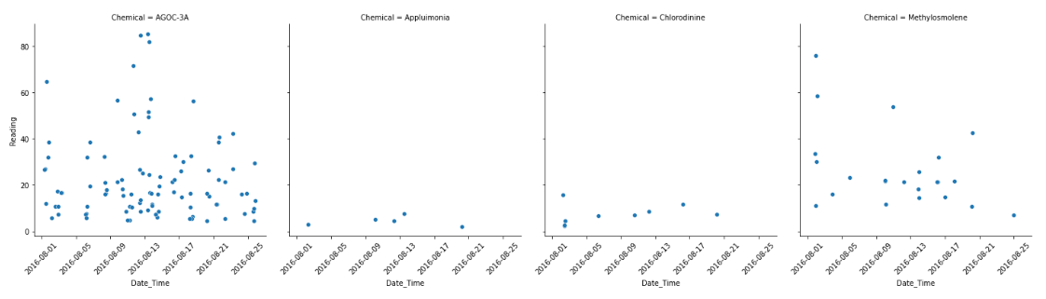
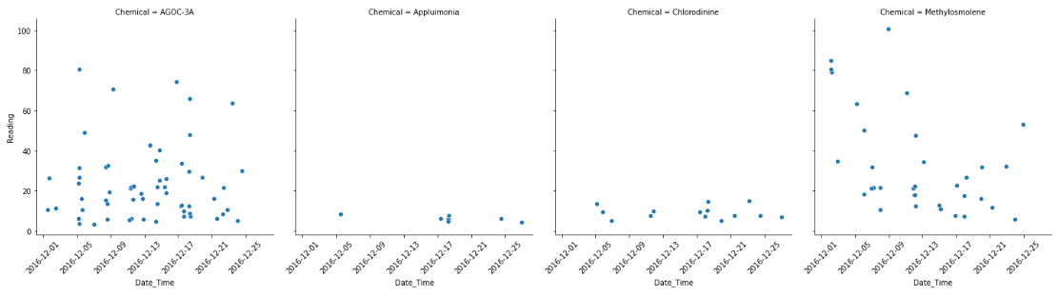
What patterns of chemical releases do you see, as being reported in the data?
April
August
December

Slide 10
What patterns of chemical releases do you see, as being reported in the data?

Slide 11
Which factories are responsible for which chemical releases?

Slide 12
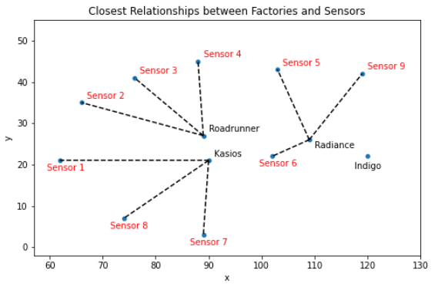
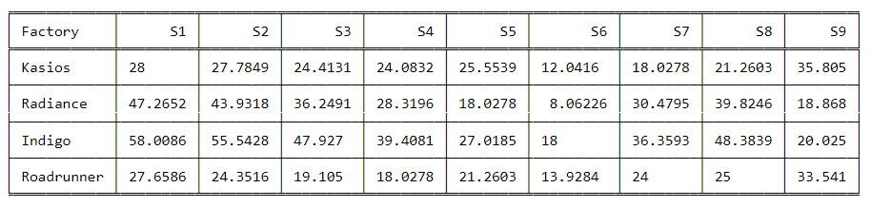
Which factories are responsible for which chemical releases?
Distance Analysis:
Kasios Office Furniture is closest to Sensors 1, 7, 8
Radiance ColourTek is closest to Sensors 5, 6, 9
Indigo Sol Boards is the furthers away from all sensors except sensor 9, however, it is not the closest factory.
Roadrunner Fitness Electronics is closest to Sensors 2, 3, 4

Slide 13
Conclusions
Time Analysis:

